Slide 1



Fortinet Educational Security Operations Centre (eSOC)
Stakeholders: Anthony Bedford, Nayson Machin, Pete Embleton, Abigail Koay, and Rania Shibl

Slide 2


Student Team
Torin Flanagan
Duc Nguyen
Fortinet eSOC Operation Management & Development
Infrastructure Development & Technical Documentation
Design & build SOC environment
Implement scenarios suitable with infrastructure.
Technical documentation across all Fortinet eSOC functionalities.
Ensure infrastructure functions relevant to scenarios.
Validate networking requirements and implementations.
Transition ideas into real deliverables.
Design & build technical infrastructure
Design & configure networking backbone
Handle system configuration and integration
Develop technical documentation of environment
Developed scenarios within designed infrastructure
Contribute to project planning and reporting
2 of 15

Slide 3

Project Background
What is an eSOC?
In our project’s context, an educational Security Operations Centre (eSOC) refers to a dedicated network infrastructure designed to continuously monitor, detect, analyse, and respond to security incidents across internal IT environment (IBM, 2022).
The Fortinet eSOC integrates cybersecurity technologies and data analysis to support hands-on learning, enabling participants to understand attack methodologies and develop effective defensive practices in a practical, educational setting.
Objective:
To develop a functioning Security Operations Centre (SOC) incorporating Fortinet technologies to fulfill educational purposes.
Goal:
Helping to bridge the gap between academia and real-world industry practices by creating a realistic, interactive, and scalable cybersecurity learning platform.
Key Deliverables:
A fully-functional eSOC environment providing cybersecurity practices.
4 cybersecurity related scenarios incorporating both attack and defence exercises.
Comprehensive documentation for providing ease of use, implementations, and future handovers.
Scalable infrastructure provides easy future integrations and developments.
Problems solved:
Promoting the cyber skills area, fulfilling job shortages.
Bridging the gap between academia and the industry.
Helps facilitate towards the limited practical learning required for cyber infrastructure.
3 of 15

Slide 4
Fortinet eSOC SWOT Analysis
Internal | Strengths | Weaknesses
 | Aids future education and learning. Provides sandbox environment. Experienced stakeholder support. Technology relevant to industry needs. Partnered with UniSC. Integrates cyber attack/defence knowledge. | Students lack technical expertise. Complex integration of systems. Time and resource constraints. Heavy reliance on Fortinet tools. Accidental or unknown misconfigurations. Inexperience with real-world deployment scenarios.
External | Opportunities | Threats
 | Continuous demands in technology industry. Industry partner/s expansion. Cybersecurity competitions (e.g. Hackathon). Adopt emerging technologies. Community outreach and collaboration. Future developments with students. | Cyber landscape constantly evolving. Vendor dependency (Fortinet) risks. Industry regulation and compliance changes. Reputational risks. Attack/defence techniques constantly changing. Rapid SOC technology advancements causing obsolescence.
4 of 15

Slide 5
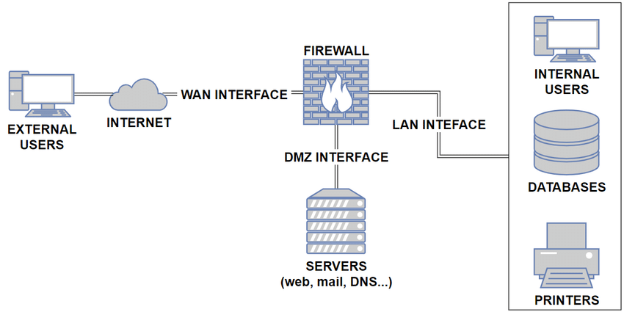
Typical Real-World Networking Infrastructure
Firewall:
Filters all incoming and outgoing data for the environment.
Internet:
All external users conducting communication attempts.
DMZ (Demilitarised Zone):
Internet facing devices (e.g. Web servers and DNS servers).
LAN (Local Area Network):
All internal users with environment (e.g. switches and desktops).
(Silva & Vale, 2021)
5 of 15

Slide 6
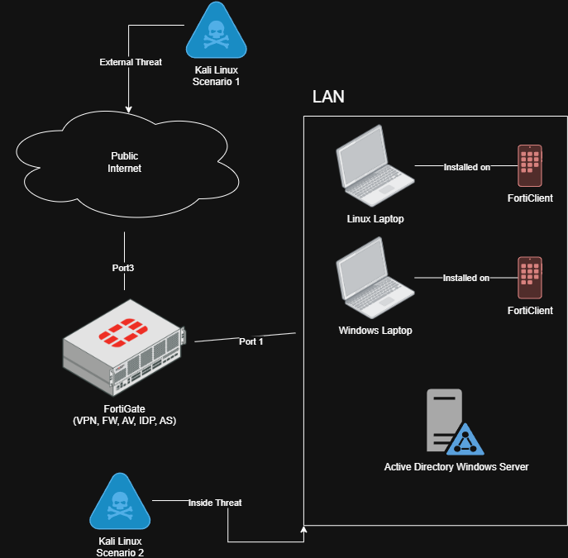
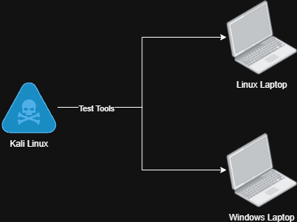
AGILE Implementation Plan
Phase 2:
Phase 1:
6 of 15

Slide 7
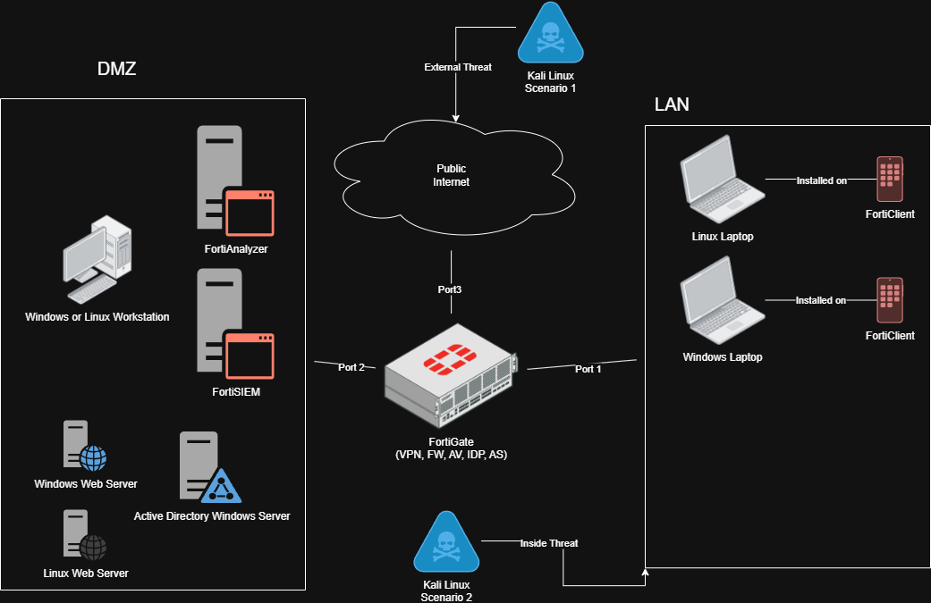
AGILE Implementation Plan
Phase 3:
7 of 15

Slide 8
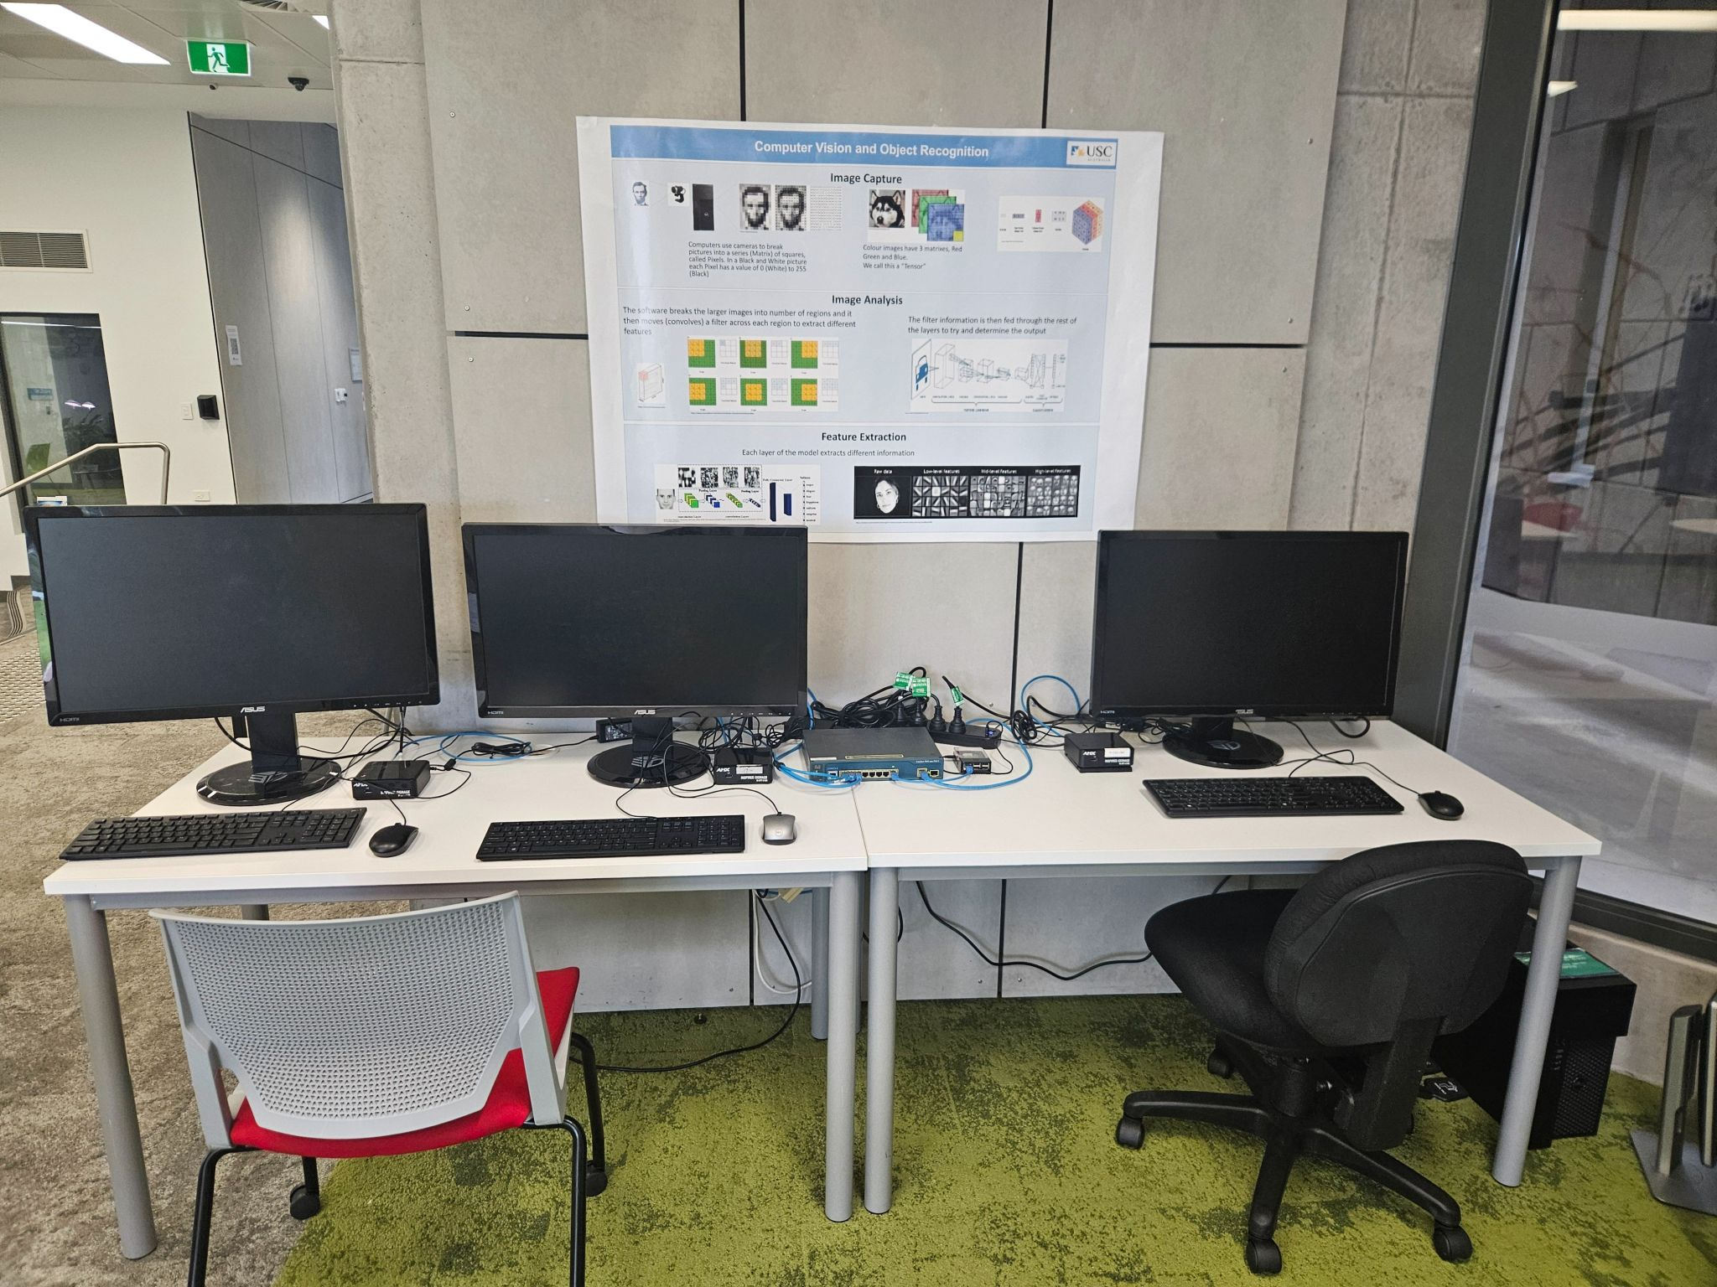

Starting Point
Intel NUCs running Windows 10:
Serve as end-user workstations within the eSOC, providing access for monitoring, analyzing, and interacting with the virtualized environment.
Intel NUC running Ubuntu Linux:
Operates as a management service for the eSOC, supporting individual VM access and core environment management functions.
VMware ESXi Hypervisor:
Hosts and manages the Fortinet eSOC VMs, allowing multiple simulated servers and network components to run efficiently on shared physical hardware.
Cisco Switch with uplink to ESXi Hypervisor:
Provides network connectivity and traffic management for Fortinet eSOC environment devices, with an uplink to the ESXi Hypervisor to enable virtualization and prevent external communications through UniSC networks.
Raspberry Pi Router:
Functions as a lightweight, custom-configured network gateway outside the eSOC, providing Internet access to the environment.
2x Intel NUCS (WINDOWS)
1x Intel NUC (LINUX)
Cisco Switch
Raspberry Pi
ESXi Hypervisor
8 of 15

Slide 9
Attack/Defence Fortinet eSOC Scenarios
Scenario | Description | Learning Outcome
Privilege Escalation via RDP | Use Kali Linux to RDP into Windows 7, extract stored admin credentials, then escalate privileges from standard to administrator level. | Weak credential storage and open RDP ports enable privilege abuse. Reinforces the need for MFA, credential hygiene, and secure remote access policies.
SMBv1 (EternalBlue – MS17-010) | An unpatched SMBv1 service on Windows 7 is exploited via using EternalBlue to achieve SYSTEM level compromise. | Unpatched legacy protocol impacts. Mirrors real-life attacks (e.g. WannaCry). Patch and vulnerability management.
VSFTP v2.3.4 Backdoor | Uses malicious username with “:)” on the end on open port 6200 to allow for remote execution. | Illustrates supply chain compromise risks. Software integrity checks. Vendor trust criticality.
PHP CGI Remote Code Execution (CVE-2012-1823) | Outdated Apache/PHP configuration is exploited, achieving remote code execution via improper query handling. | Secure coding criticalities. Web-server patching. Regular vulnerability scanning.
9 of 15

Slide 10
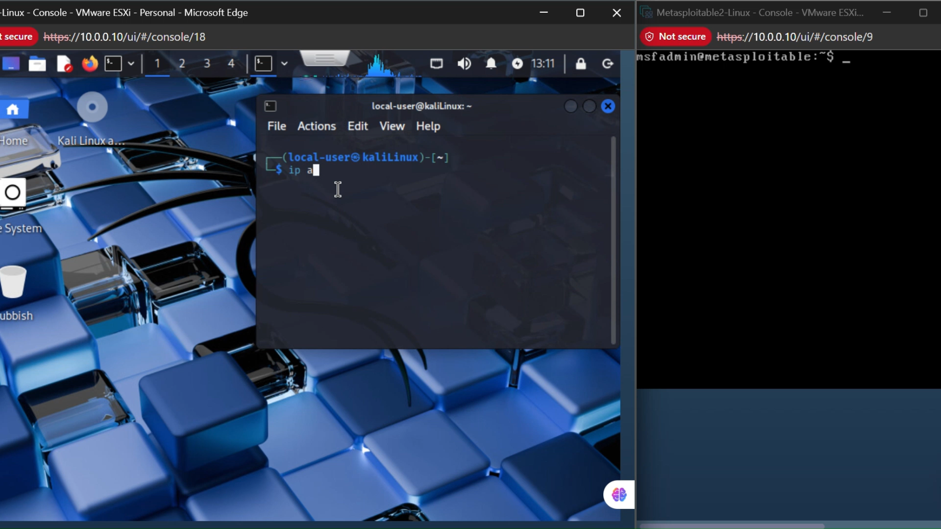
Scenario 4 Simulation Video

Slide 11
Scenario 4 Vulnerability Assessment
CVE-2012-1823 Identification:
Affects sapi/cgi/cgi_main.c in PHP web development scripting language versions prior to 5.3.12 and 5.4.x before 5.4.2 when configured as a CGI protocol script (php-cgi).
Does not properly handle query strings that lack an = sign character
Allows remote code execution for arbitrary code by placing command line options in the query string.
Vulnerability Analysis:
Root Cause – Improper command-line argument sanitation in PHP-CGI mode.
Affected Systems – Any web servers running PHP in CGI configuration (e.g. Apache or Nginx).
Base Score – 9.8 (Critical)
Impact – Expose sensitive data or allow server compromise.
Remediation:
Mitigation – Upgrade PHP to 5.3.12/5.4.2 or later.
Alternative Controls – Disable CGI mode or filter malicious query strings via .htaccess or web application firewalls.
Ongoing Practice – Apply vendor patches promptly and conduct routine vulnerability scans.
(NIST, 2012).

Slide 12
Problems Encountered
Infrastructure Setup
Network configuration issues
Limited access for technical support.
Week 5 - Fortinet VM deployments.
Week 8 - Integrating the fog server for replication
Week 12 - Fortinet Licensing leading to limitations
Notes:
DUC
Fortinet VM’s
Fortinet VM’s were not uploading onto ESXi
Weeks of troubleshooting
Reviewed OVF file configs, match with new VM settings
Used Qemu tools to see if we can convert the file
Used own workstation to upload the vm’s and it worked
Pinpointed it down to a permission issue
Given root admin, can upload VM(Wk11)
Network issues
Throughout the project there were network troubleshooting issues
Kali Linux didn’t want to ping a VM in the same network
The physical nature of the switch and virtual vswitch lead to some MAC address inconsistencies between physical machines and vms/
Limited Technical support
One of our stakeholders who assisted with setting up the infrastructure was away. So we had to take on the responsibility all ourselves/
Integrating fog server
- Recommended by the lecturer to try and integrate the fog server for quick replication of VMS. It allows us to save a state of an OS and restore that state at a later time. - Unable to integrate due to lack of knowledge, time and easier alternative (VMWARE esxi snapshots)

Slide 13
Concluding Remarks
Successes | Downfalls | Current Standing | Reflection
Completed phase 3 infrastructure development/configuration. All scenarios successfully developed and integrated. Fully developed documentation. Easy future transition. Developed foundations for future SOC integration. | Limited Fortinet vendor integrations. Licensing and account expirations. Single product family. Scenarios are only simulations No SIEM or Dashboard for visual monitoring and alerts. | Functional infrastructure. FortiGate setup with routing Infrastructure incorporates AD, FOG, WIN, LINUX VM’s and more. 4 attack/defence scenarios | Gained technical and industry relevant skills in enterprise systems. Developed skills within networking, security, penetration testing, and management. Better understand the learning of systems used to secure enterprises.

Slide 14

Questions
14 of 15

Slide 15
Reference List
IBM. (2021, November 24). Security Operations Center. Ibm.com. https://www.ibm.com/think/topics/security-operations-center
NIST. (2012). NVD - cve-2012-1823. Nist.gov. https://nvd.nist.gov/vuln/detail/cve-2012-1823
Silva, L. F. C., & Vale, S. B. (2021). A Methodology for Network Security Infrastructure according to the New Brazilian General Law for Personal Data Protection. International Journal of Computer Applications, 183(17), 1–8. https://doi.org/10.5120/ijca2021921520

